Slide 1
Evolutionary Computation (Part I, Spring 2022)
Instructor: Dr. Yanan Sun (ysun@scu.edu.cn)
Department of Artificial Intelligence
College of Computer Science, Sichuan University

Slide 2
Syllabus
Course: Evolutionary Computation - Part I (进化计算_01), Spring 2022
Time: Tuesday 10:15-11:55 (第3-4节课，第二大节)
Place: D506, No.1 Building, Jiangan Campus (江安一教D座D506)
Objectives
Knowing the computational intelligence (CI), Evolutionary Computation (EC), and their top-ranking journals and conferences.
Can solve some traditional optimization problems by using the simulated annealing algorithm, genetic algorithm and particle swarm optimization algorithm.
Knowing the multiple and many-objective optimization problems as well as the evolutionary neural architecture search.

Slide 3
Course Policy
Grading
Attendance 20%.
Performance 50%
(Homework: 20%, two presentations: 25% and interaction (at least twice): 5%).
Final report 30%.
Attendance
Attendance record will be sampled randomly and counted toward your grade.
Students will be expected to attend class.
Habitual failure to do so will result in a reduced grade/score.
An incomplete grade will only be given when a student misses a portion of the semester because of illness or accident.

Slide 4

Class QQ group
After joining the group,
the naming format is:
name_student number.
Notes:
2分钟加群，同学们进群后，按照公告进行命名，之后的作业均会在群中进行通知。

Slide 5
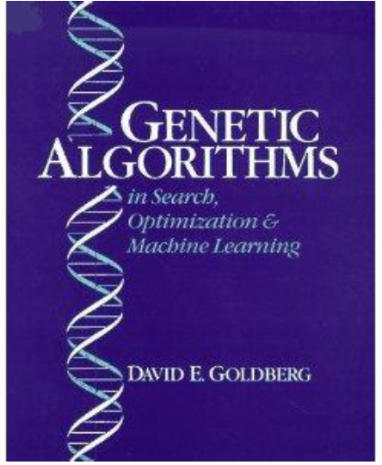
Textbook
Genetic Algorithms in Search, Optimization & Machine Learning
(ISBN 0-201-15767-5)
by David E. Goldberg
Addison-Wesley, 1989

Slide 6
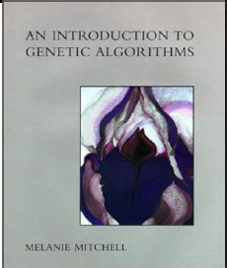

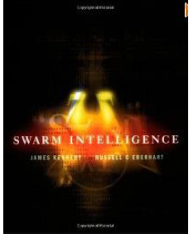
References
An Introduction to Genetic Algorithms, MIT, 1996
by Melanie Mitchell
Ant Colony Optimization, MIT, 2004
by Marco Dorigoand Thomas Stutzle
Swarm Intelligence, Morgan Kaufmann, 2001
by James Kennedy and Russell C. Eberhart

Slide 7
Instructor
Professor (Research) Yanan Sun, PhD (孙亚楠、博导、拔尖班指导老师)
https://cs.scu.edu.cn/info/1288/13623.htm (official)
https://yn-sun.github.io (personal)
M: 18011452539, Email: ysun@scu.edu.cn
B422B, Basic Building, Wangjiang Campus
Research Topics
Neural Architecture Search (NAS), AutoML(Effectiveness, Interpretability, Robustness)
low-power consumption AI models (Mainly for CV tasks)
Evolutionary multi- and many-objective optimization

Slide 8
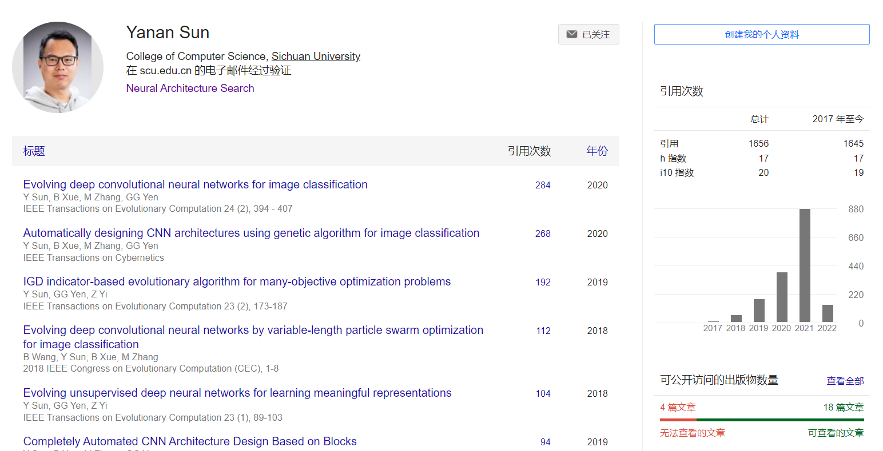
Google Scholar Profile

Slide 9
Supervision@SCU
2021 PhD Students
Xiangning Xie (1 Trans., 1 Trans. Paper in submit), Shengjia Chen, Zeqiong Lv (1 CCF A Paper in submit)
2021 Master Student
Peng Zeng, Xiao Yang, Yuwei Ou, Zixuan Liang
2020 Master Student
Yuqiao Liu (1 CCF A, 1 Trans., 1 CCF A Paper in submit), Siyi Li (1 Patent, 1 Trans.), Jie Wu
Notes:
上述仅展示顶会顶刊，不包含其他的次级刊物等。特别说明，CCF A 和Trans. 都属于计算机领域的顶会顶刊。计算机学院一年所有老师和学生共计发表的顶会顶刊不过几十篇，博士毕业两篇顶会就可以评为优秀毕业博士，而我带的学生如刘渝桥今年研二的学生已经发表两篇顶会顶刊，已经达到优秀博士的要求；也有入学一年级的博士发表顶刊。

Slide 10
Undergraduate Student Thesis
2021
Computer Science:Yiheng Wang, Wenxin Zhao, Yuesong Feng, Siyi Wu, Youxiang Huang, Guanhong Liu
Software Engeering: Xiangning Xie (Best Undergraduate Thesis Award), Jiajun Yan
Foreign students: Ahammad Akbar Bin Kabir, Md Ilius Mahfuz， Mahamendige Dakshana Tharinda Mendis, Md Abdul Mazed Siddiki, Pasindu Himantha Kumara Merrennya, Alvin Reuben Walker, K. Gedara Mudiyansela Dulmini Nilushi B.

Slide 11
Undergraduate Student Thesis
2020
Computer Science: Yuqiao Liu (Best Undergraduate Thesis Award), Yunxiang Song, Weizhen Xu, Siyi Li
Software Engeering: Yi Chen, Haoming Wang
Foreign students: Preman Dewasiri Ishara Shaminda, Malinda Rukshan, Santosh Ghimire, Rohit Sharma

Slide 12
Supervision@VUW
2020
Phd Student: Junhao Huang (co-supervised with Bing Xue, Mengjie Zhang), “Evolutionary Design of Deep Neural Networks”, 2020-2024
2019
Summer Scholar: Bin Wang (co-supervised with Bing Xue, Mengjie Zhang), “Evolving deep neural networks by multi-objective particle swarm optimization for image classification Publications”, in this research, Bin has produced two papers that have been accepted by GECCO2019 and PRICAI2019, respectively.
2018
Honours (Master Student): William Irwin-Harris (co-supervised with Bing Xue, Mengjie Zhang), “Genetic programming for automatic design of convolutional neural network architectures”, In addition to the final report, William has produced two papers including one accepted by CEC2019 and the other submitted to TEVC for review.
Honours (Master Student): Bin Wang (co-supervised with Bing Xue, Mengjie Zhang), “Evolving deep neural networks for image classification”, In addition to the final report, Bin has produced one paper accepted by AI2018.
2017
Summer Scholar: Bin Wang (co-supervised with Bing Xue, Mengjie Zhang), “Evolving deep convolutional neural networks by variable-length particle swarm optimization for image classification”, in this research, Bin has been produced one paper that has been accepted by CEC2018.

Slide 13
Office Hours
Regular office hours are scheduled each week to meet with any student
who needs assistance with this course
who needs professional, career, curriculum, or technical advice
All students are encouraged to make most use of office hours
The office hours are:
Wednesday/Thursday whole day
or by appointment only

Slide 14
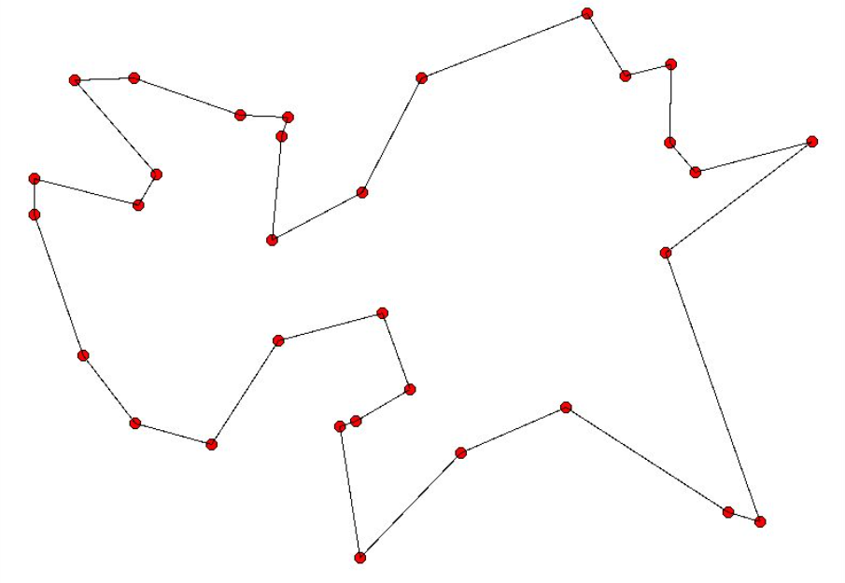
Practical problems
The Traveling Salesman Problem (TSP) is a question that given a series of cities and the distance between each pair of cities, wants to know what is the shortest route to visit each city once and return to the starting city?

Slide 15
Methods
Violent enumeration
branch bounding
linear programming
dynamic programming
……..
These methods face problems such as high computational complexity and long computation times. Computational intelligence, on the other hand, can deal with such practical problems very well.

Slide 16

Computational Intelligence
Computational intelligence (CI) usually refers to the ability of a computer to learn a specific task from data or experimental observation (Data-driven?).
CI is a set of
nature-inspired computational methodologies
and approaches to address complex real-world problems to which mathematical or traditional modelling can be useless
the processes might be too complex for mathematical reasoning
it might contain some uncertainties during the process
the process might simply be stochastic in nature

Slide 17
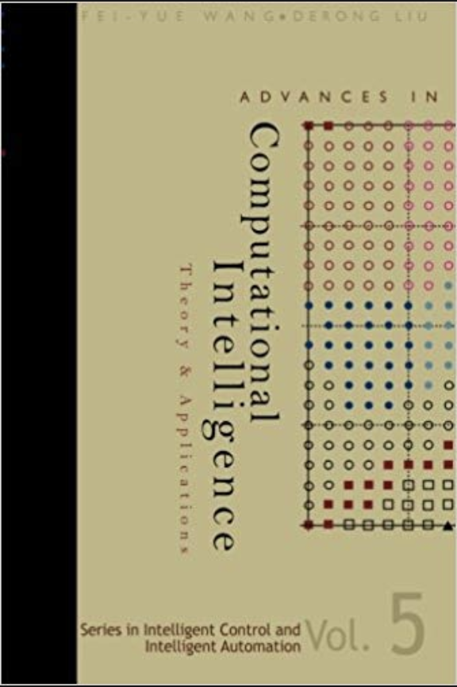
A Quote from A Book
“Advances in Computational Intelligence, Theory and Applications,” edited by Fei-Yue Wang and Derong Liu.
Computational Intelligence is the study of adaptive mechanisms to enable or facilitate intelligent behaviors in complex and changing environments.
Computational Intelligence is the computational part of the artificial intelligence.

Slide 18
Definition
Any biologically, naturally, and linguistically motivated computational paradigms include, but not limited to,
neural network(basis of deep learning->foundation of today’s AI),
fuzzy system,
evolutionary computation,
autonomous mental development
and hybrid intelligent systems in which these paradigms are contained.
Any nature-inspired computational paradigms for problem solving…

Slide 19
Review
A、B
The correct definitions of computational intelligence are those ( )
A. Computational intelligence (CI) usually refers to the ability of a computer to learn a specific task from data or experimental observation.
B. Any biologically, naturally, and linguistically motivated computational paradigms include, but not limited to neural network, etc.
C. Computational intelligence is a family of algorithms for global optimization inspired by biological evolution, and the subfield of artificial intelligence and soft computing studying these algorithms.
D. Computational intelligence is simply traditional artificial intelligence.
Evolutionary Computation
Two concepts

Slide 20
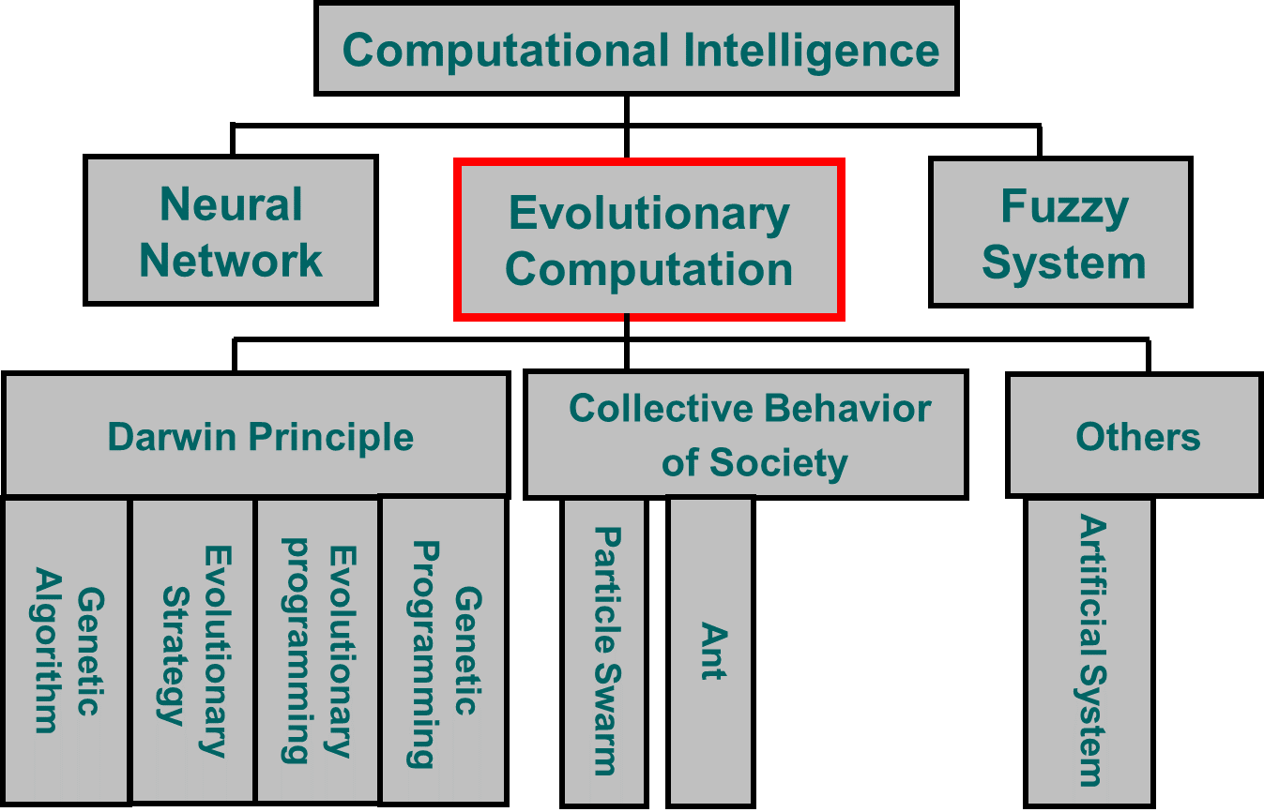
Overview

Slide 21
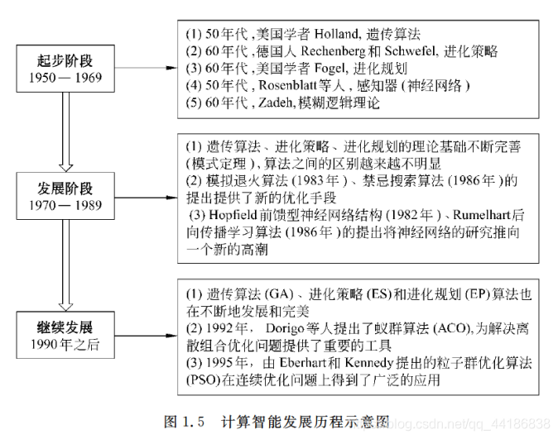
Development History
Notes:
类比计算智能的发展，做学术也需循序渐进，没有捷径。
做学术需脚踏实地循序渐进地进行，正如同我党创立至今，从一穷二白到如今世界第一大党，这正是一步一个脚印探索出来的；再者，如同新中国到现在的世界大国，历史已经证明在发展建设中需要循序渐进，反之则会产生负面效果。
做学术的路上充满乐趣与挑战。
当你沉浸其中，将其作为事业来奋斗，意志坚定拒绝诱惑，那么你会发现这条路上充满乐趣；当然，做学术的路上亦是充满挑战，例如，进化计算领域的程然教授，曾为一篇文章的修订和反复实验足足花了将近两年的时间，期间将编译的快捷键都敲坏了，这就是面对的挑战，这也是考验学术者是否有解决问题的恒心和毅力。

Slide 22
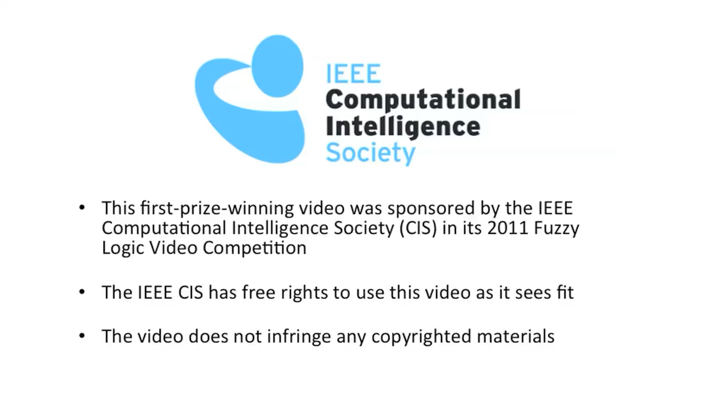
Fuzzy Logic

Slide 23
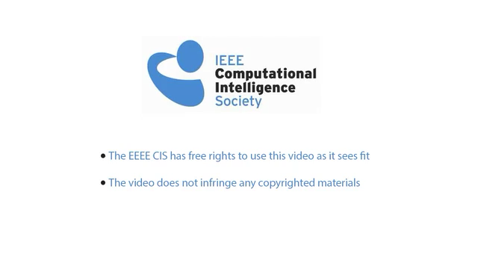
Artificial Neural Network

Slide 24
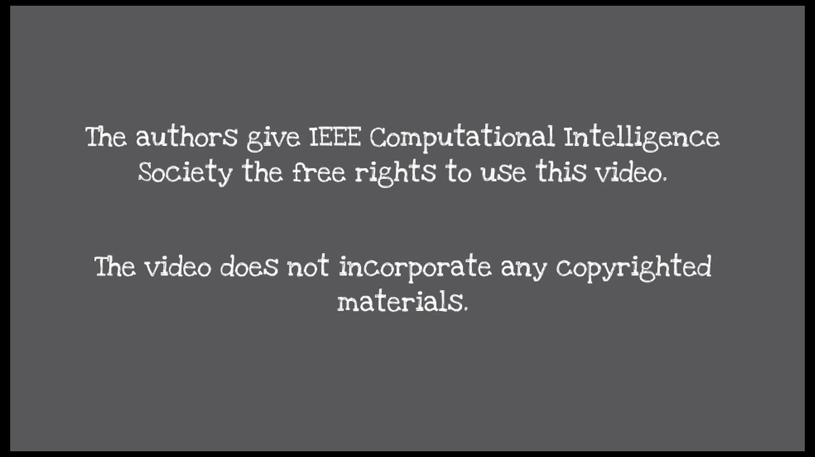
Evolutionary Computation

Slide 25
The Origin
Nearly all inventions have a counterpart in or are an extension of nature.
thermonuclear explosions occur in the stars
pulse modulation occurs in the human nervous system
bats have sonar and dolphin pings serve as a subterranean telephone
Nature/biology inspires invention
Engineering uses science and mathematics to emulate and extend nature
As the bird motivates air flight, so does human/biological intelligence motivates study of advanced computational paradigms.

Slide 26

A Practical Example-Velcro

Slide 27


Common Characteristics
Biologically motivated behavior such as learning, reasoning, or evolution (in the sense of approximation)
Parallel, distributed information processing
Mysterious power under real-world complications
Lack of qualitative analysis
Non-repeatable outcomes
Stochastic nature
Is this a panacea for our modern-day problems?

Slide 28
CI vs. Intelligent Systems (IS)
IS covers on all aspects of artificial intelligence, focusing on the development of the latest research into practical, fielded applications.
CI, on the other hand, is a collective effort in emerging, fundamental computational paradigms.

Slide 29
CI vs. Artificial Intelligence (AI)
CI depends upon numerical data supplied by manufacturers and does not rely on “knowledge.”
AI, on the other hand, uses “knowledge tidbits” and these knowledge is derived from human expert.
The knowledge or intelligence exhibited from CI is self-emerging and spontaneous as opposed to man-made and artificial from AI.

Slide 30
Critical Message Conveyed
Any nature-inspired computational paradigms
for problem solving…
is
Computational Intelligence

Slide 31
Review
Classification：Computational intelligence consists of three main components: artificial neural networks, fuzzy logic, and evolutionary computation.
Common Characteristics：Biologically motivated behavior such as learning, reasoning, or evolution (in the sense of approximation)、parallel, distributed information processing and mysterious power under real-world complications.
Comparison: CI vs. Intelligent Systems (IS) and CI vs. Artificial Intelligence (AI).

Slide 32
IEEE COMPUTATIONAL INTELLIGENCE SOCEITY
……..

Slide 33

IEEE

Slide 34
IEEE Divisions
Circuits and Devices
Industrial Applications
Communications Technology
Electromagnetics and Radiation
Computer
Engineering & Human Environment
Energy and Power Engineering
Computer
Signals and Applications
Systems and Control
Computational Intelligence Society
Control Systems Society
Engineering in Medicine and Biology Society
Photonics Society
Robotics and Automation Society
Systems, Man and Cybernetics Society
Biometrics Council
Systems Council

Slide 35
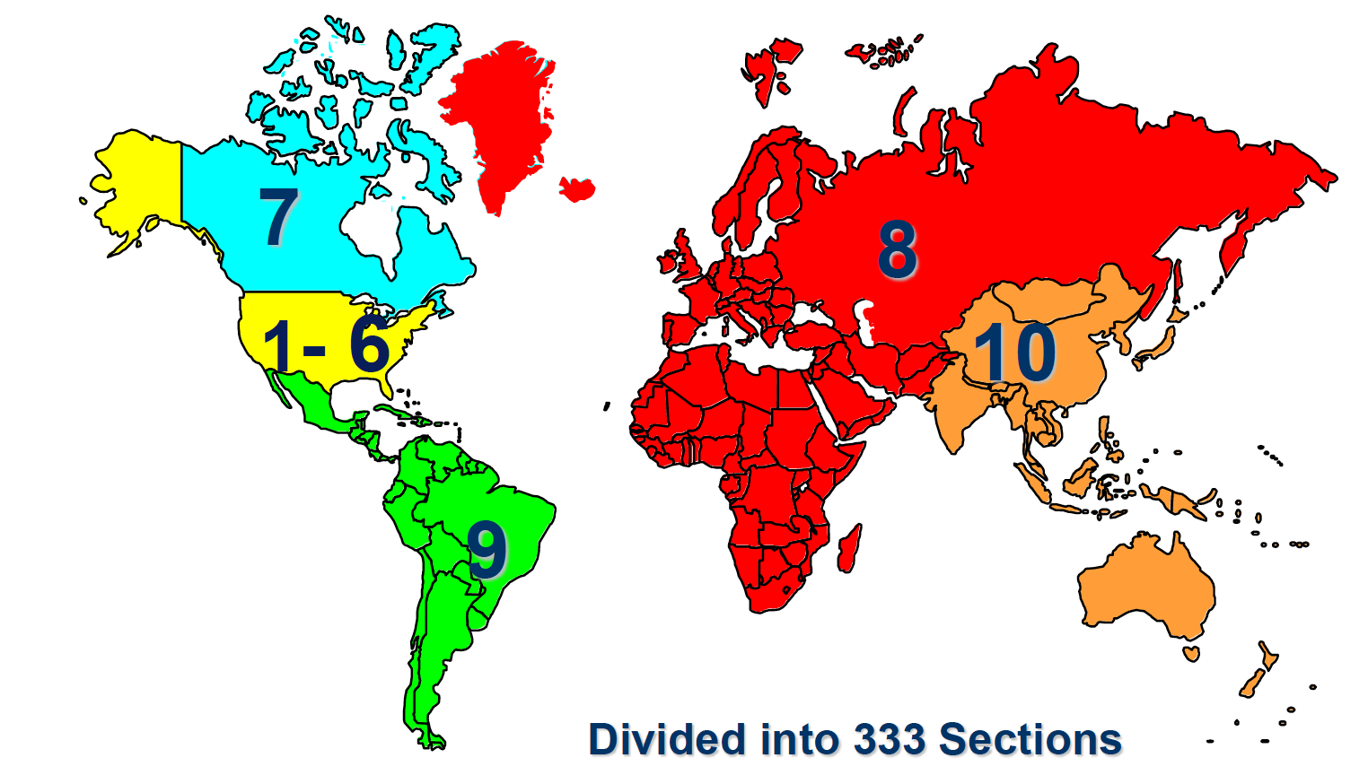
IEEE Regions

Slide 36
IEEE CIS
Neural Network Council was created in 1990
Transformed into Neural Network Society in 2001
Name changed to Computational Intelligence Society in 2005
Currently have 7,000+ members
$4,000,000 in reserves
Publish TNNLS (11.683)/TEVC (8.508)/TFS (8.759)//CIM (5.857)/TCIAIG(1.506)/TCDS(2.755)/TETCI
Hold annual conferences on IJCNN, FUZZ-IEEE, CEC, WCCI, SSCI, ICDL, CIG, CIBCB, CIMSA
Field of Interest: is the theory, design, application, and development of nature-inspired computational paradigms.

Slide 37
Technical Activities
Bioinformatics
Evolutionary Computation
Computational Finance
Fuzzy Systems
Intelligent Systems Applications
Neural Networks
Emergent Technologies
Autonomous Mental Development
Data Mining
Computational Games
Approximate Dynamic Programming & Reinforcement Learning

Slide 38
Applications Task Forces
Aerospace applications
Computational Finance and Economics
Data Mining
Automotive applications
Software engineering
Virtual reality
Intelligent control and factory automation
Speech and vision processing
Telecommunications
Business Intelligence
Biometrics
Intelligent measuring systems
Homeland security
and etc

Slide 39
Sponsored Publications

Slide 40
Technical Committees-1
Technology-oriented TCs promote CI technologies
Neural Networks
Fuzzy Systems
Evolutionary Computation
Cognitive and Developmental Systems
Adaptive Dynamic Programming and Reinforcement Learning
Application-oriented TCs deal with applications of CI technologies
Bioinformatics and Bioengineering
Computational Finance and Economics
Data Mining
Games
Smart World

Slide 41
Technical Committees-2
Incubator TCs identify and nurture new CI technologies and new areas for CI applications
Emergent Technologies
Intelligent System Applications
TF1…
…
TF7: ISATC "Evolutionary Deep Learning and Applications" Task Force, Chair: Yanan Sun
…

Slide 42
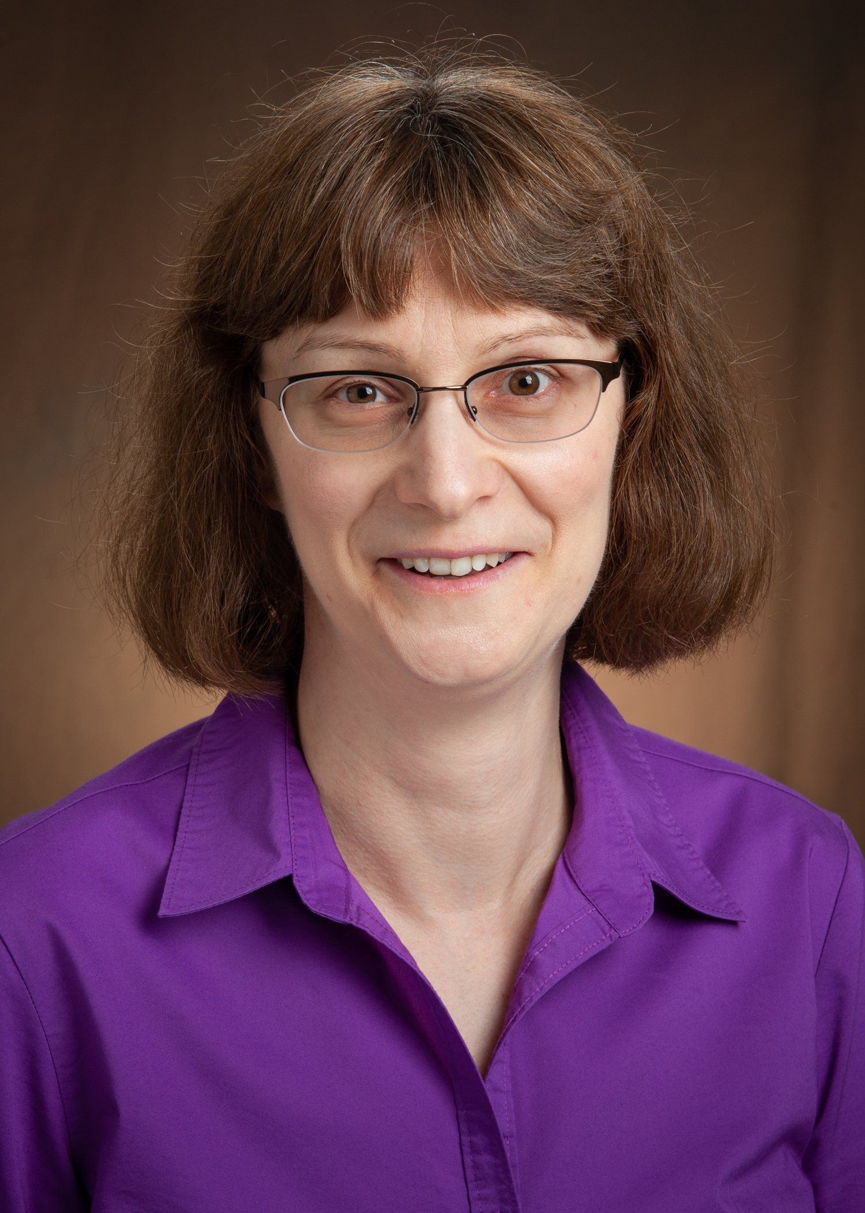
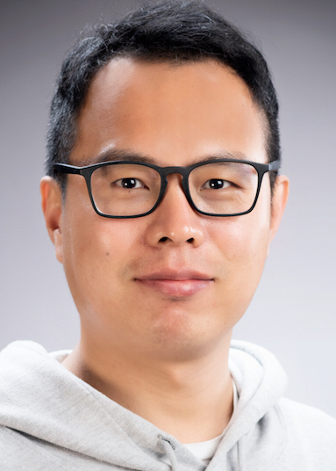
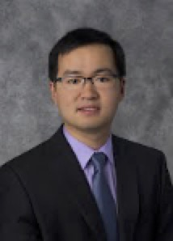

Professional Development
Webinars
Summer Schools
...
Graduate student Research Grants
Simone Ludwig, Chair
North Dakota State University, US
Yanan Sun
Sichuan University, CN
Zhen Ni
Florida Atlantic University, US
Ana Bazzan
Federal University of Rio, BR

Slide 43
Sponsored Conferences
International Joint Conference on Neural Networks (IJCNN)
International Conference on Fuzzy Systems (FUZZ-IEEE)
Congress on Evolutionary Computation (CEC)
International Symposium on Computational Intelligence in Bioinformatics and Computational Biology (CIBCB)
International Conference on Computational Intelligence in Games (CIG)
International Conference on Developmental Learning(ICDL)
International Symposium on Computational Intelligence for Measurement Systems and Applications(CIMSA)
International Conference on Computational Intelligence for Homeland Security and Personal Safety(CIHSPS)

Slide 44
WCCI
1994, Orlando, Florida
1998, Anchorage, Alaska
2002, Honolulu, Hawaii
2006, Vancouver, Canada
2008, Hong Kong, China
2010, Barcelona, Spain
2012, Brisbane, Australia
2014, Beijing, China
2016, Vancouver, Canada
2018, Rio de Janerio, Brazil
2020, Glasgow, UK
2022, Padua, Italy

Slide 45
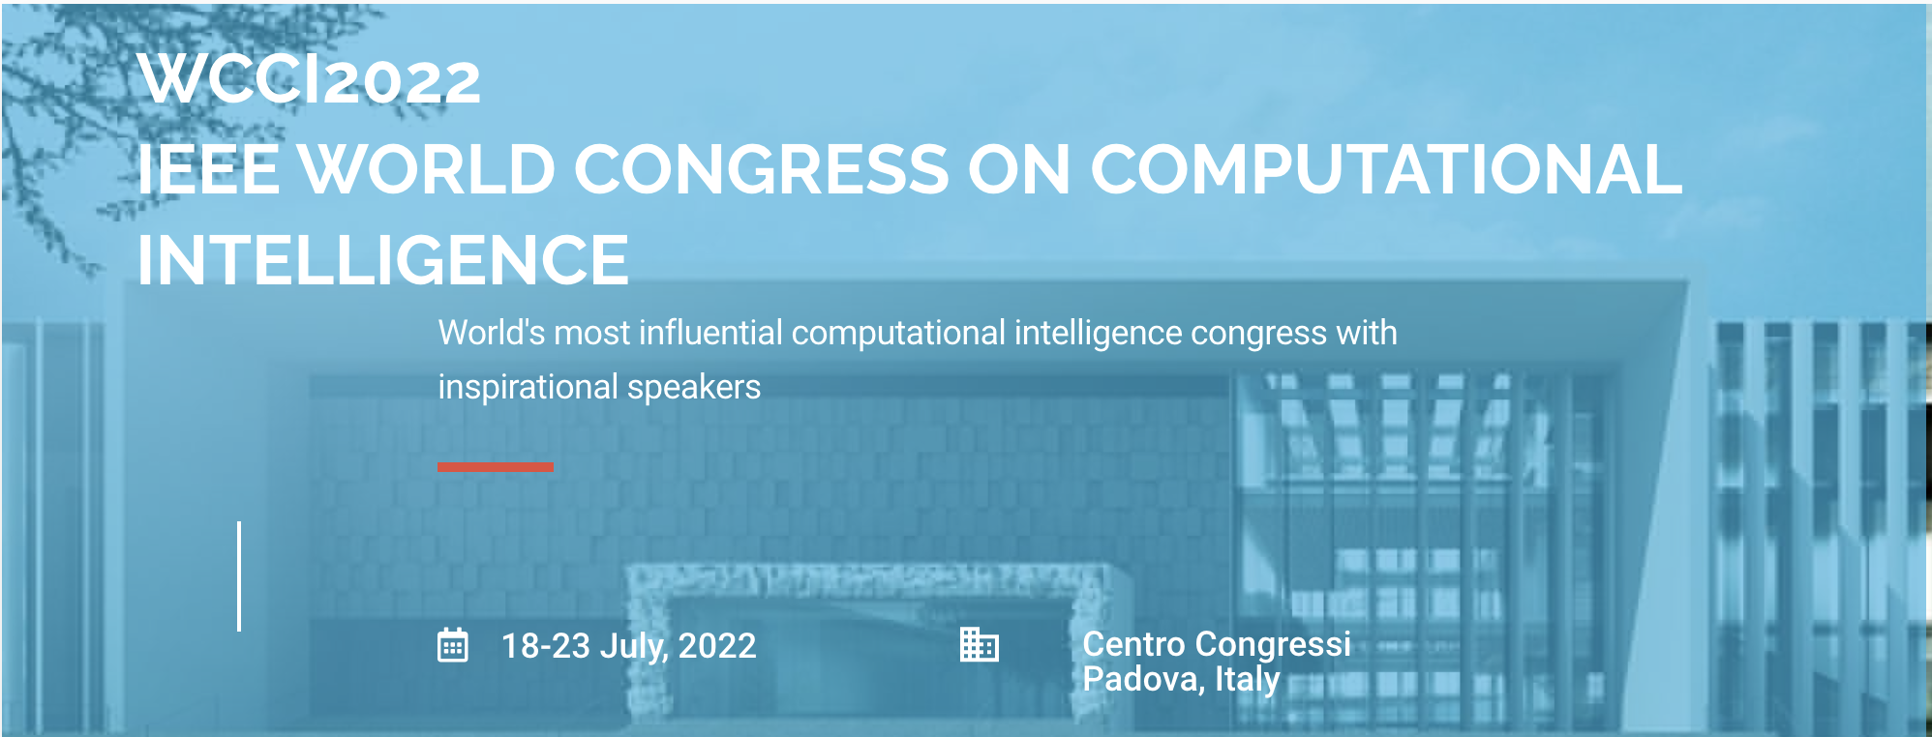
WCCI2020

Slide 46

SSCI
IEEE Symposium Series on Computational Intelligence
2007, Honolulu, Hawaii
2009, Nashville, Tennessee
2011, Paris, France
2013, Singapore
2014, Orlando, Florida
2015, Cape Town, South Africa
2016, Athens,Greece
2017, Honolulu, Hawaii
2018, Bengaluru, India
2019, Xiamen, China
2020, Canberra, Australia
2021, Florida, USA

Slide 47
IEEE Membership
Student Member/Member
Senior Member
Have been in professional practice for at least ten years (including PhD study)
IEEE Fellow
Has significant contribution to some fields
IEEE Life Fellow
Recognize to IEEE Fellows who have been 80 years’ old

Slide 48
Critical Message Conveyed
To proactively participate in
professional community
help to grow your career.

